Slide 1

IDEAL/APPROACH DETAILS MINISTRY/ORGANISATION NAME : COAL INDIA LIMITED PROBLEM STATEMENT : MOVING VEHICLE REGISTRATION PLATE DETECTION
PS NUMBER : NC740
DOMAIN : TRANSPORTATION & LOGISTICS TEAM LEADER NAME : NITESH P B
DEPARTMENT : COMPUTER SCIENCE AND ENGINEERING
ROLL NUMBER : 2021UCS1123 (7376211CS232)

Slide 2

ABSTRACT :
An intelligent coal mine security system using data acquisition method utilizes sensor, automatic detection, communication and micro controller technologies to realize the operational parameters of the mining area. This system implements real-time monitoring and displaying data undermine queries. The research development and promote application will provide the safeguard regarding the mine pit control in accuracy, real time capacity and has high reliability. To create an anti-theft auto security system that can extract registration number from number plate of moving vehicle. And can capture and transfer data to cloud, which can be available for further analysis of theft or proof reading. This helps us to track the real-time location and monitoring, especially of moveable assets such as the vehicle fleet transporting the coal. Tracking pickups and deliveries of thousands of truck-loads moving daily to and from various locations inside mining areas to processing plants, rail wagons or jetties is a logistics nightmare.

Slide 3

PROBLEM STATEMENT
MOVING VEHICLE REGISTRATION PLATE DETECTION

Slide 4

IDEA DESCRIPTION
❶ Real-time location tracking and monitoring, especially of movable assets are tracked.
❷ RFID is fitted with the vehicles moving across the mining region.
❸ The RFID’s are mapped to their respective registration number.
❹ A system is created to extract registration number from the number plate of the moving vehicle using CCTV cameras at the mining regions.
❺ The data captured is transferred to cloud for further analysis.

Slide 5

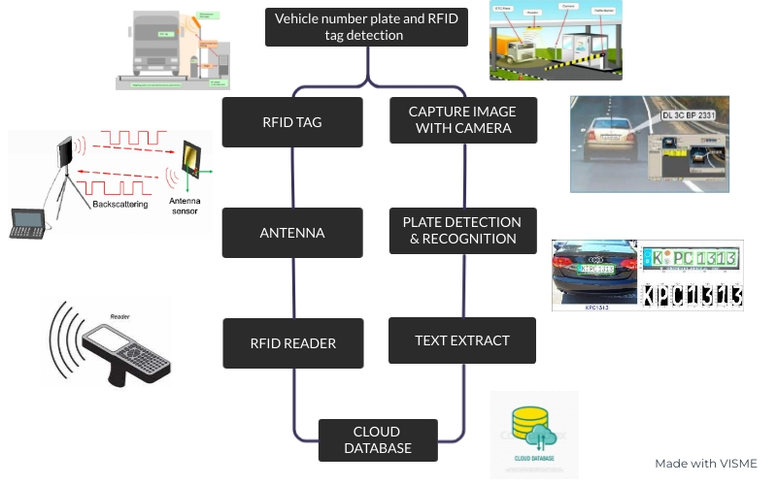
TECHNICAL STACK

Slide 6

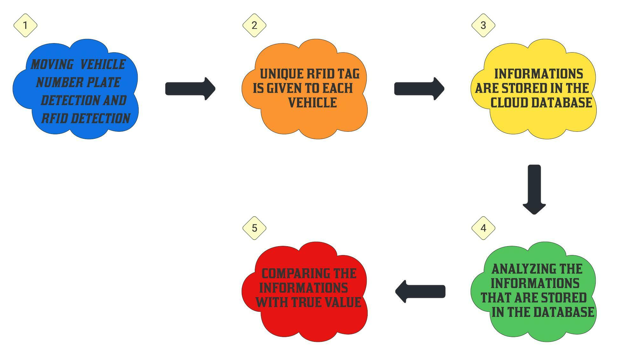
USE CASE
: CRIPTION:

Slide 7

DEPENDENCIES
● CCTV Camera
● Strong internet connections
● RFID READER(INTERROGATOR)
●RFID TAG

Slide 8

THANK YOU

